Slide 1

Cancer Prediction Using DNA
Breast Cancer Prediction Using DNA Mutations

Slide 2
Agenda
1.
Project Overview
2.
Cancer Prediction Techniques
3.
DNA & Mutations
4.
Progress So Far

Slide 3
Agenda
1.
Project Overview
2.
Cancer Prediction Techniques
3.
DNA & Mutations
4.
Progress So Far

Slide 4

Objective
Project Overview
To develop a tool for breast cancer prediction using DNA mutations

Slide 5

Why this matters?
Project Overview
Early detection saves lives
DNA mutations offer specific and actionable insights

Slide 6
Agenda
1.
Project Overview
2.
Cancer Prediction Techniques
3.
DNA & Mutations
4.
Progress So Far

Slide 7
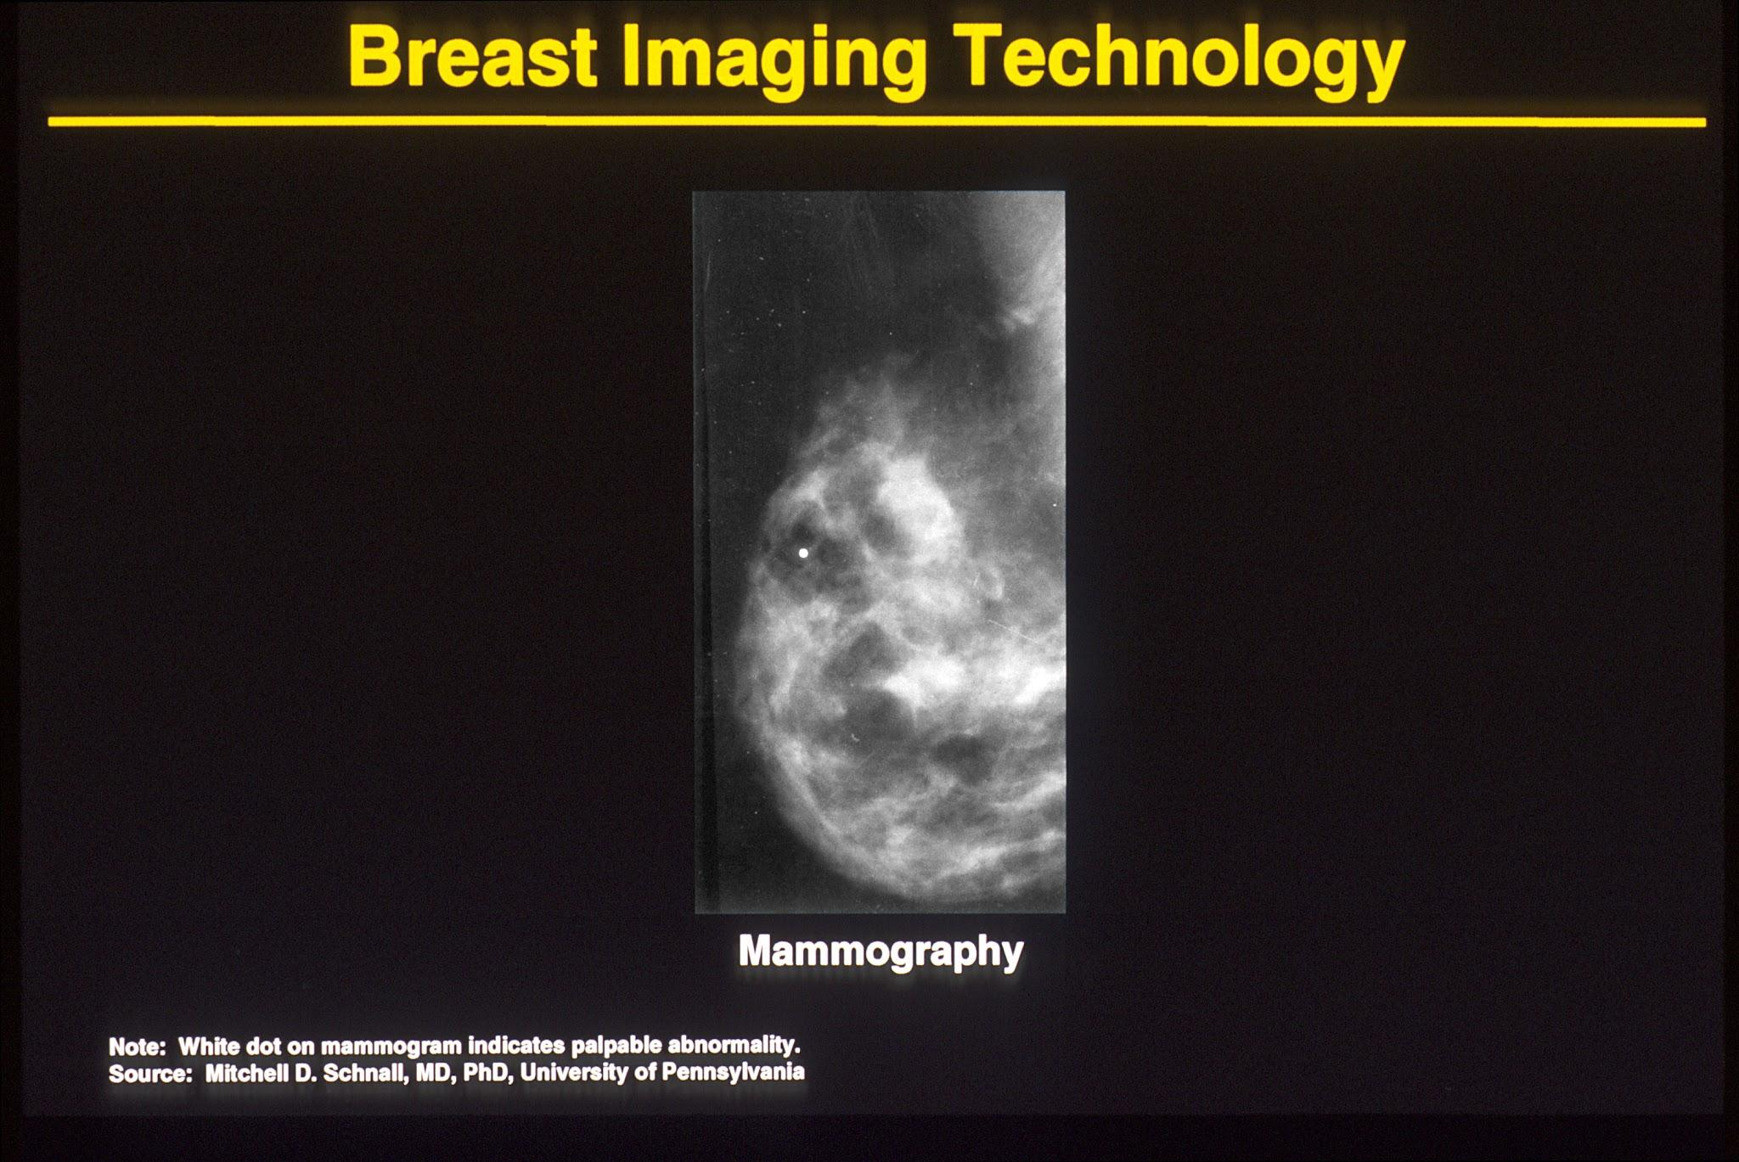
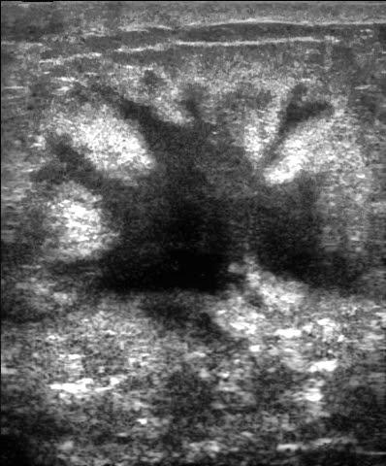
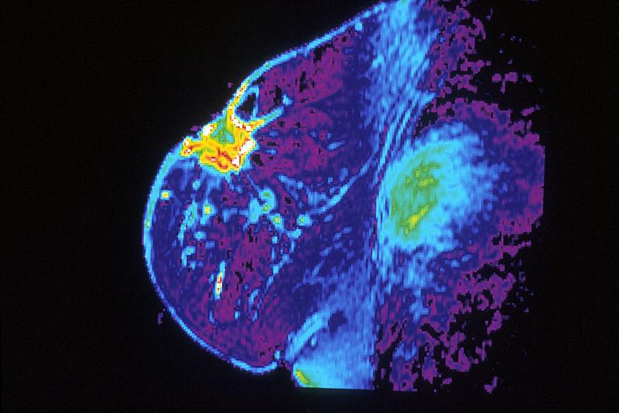
Imaging-Based Techniques
X-Ray
Ultrasound
MRI
Cancer Prediction Techniques
Science Presentation
Description: X-ray imaging of the breast to detect abnormalities.
Strengths: Non-invasive, widely used for routine screening.
Limitations: Limited sensitivity in dense breast tissue, can lead to false positives/negatives.
Description: Uses sound waves to produce images of breast tissue.
Strengths: Effective for dense breasts; complementary to mammography.
Limitations: Operator-dependent and less effective for detecting microcalcifications.
Description: Produces detailed breast images using magnetic fields and radio waves.
Strengths: High sensitivity; useful for high-risk patients.
Limitations: Expensive, not ideal for routine screening.

Slide 8

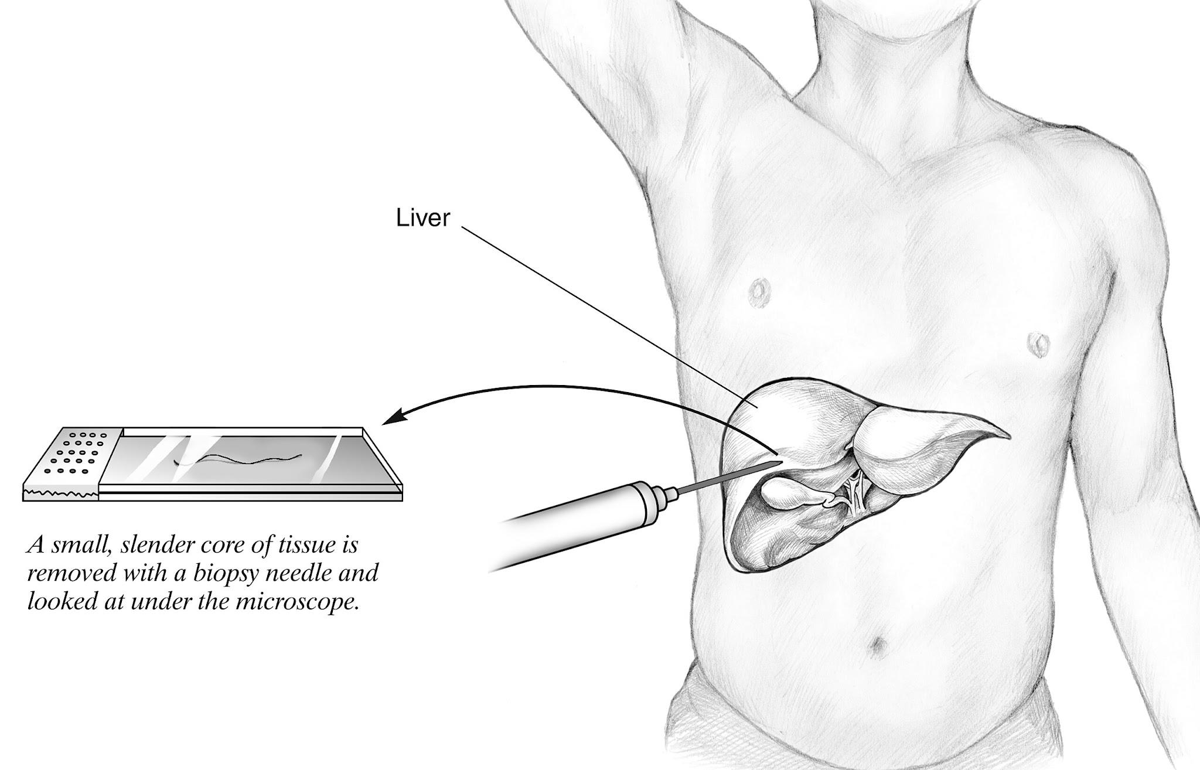
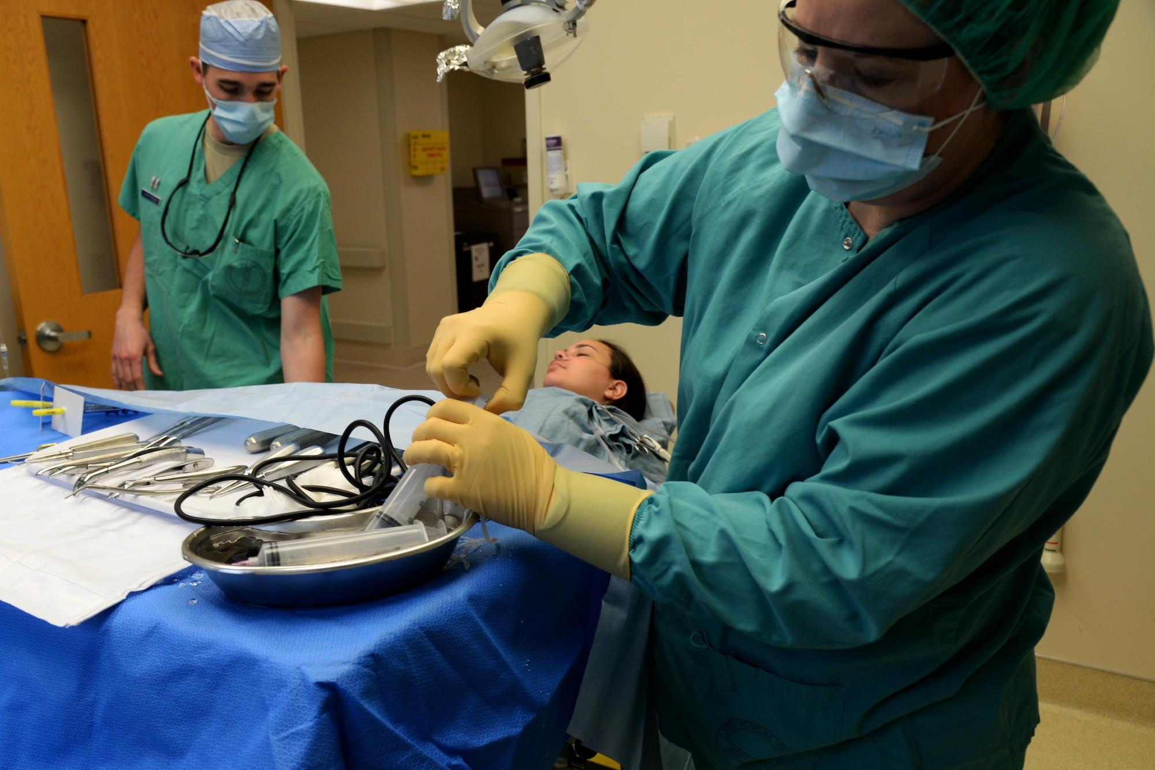
Biopsy-Based Techniques
Fine Needle Aspiration
Core Needle Biopsy
Surgical Biopsy
Cancer Prediction Techniques
Science Presentation
Description: Thin needle extracts a small sample of tissue or fluid for analysis.
Strengths: Minimally invasive, quick.
Limitations: May not provide sufficient information for a definitive diagnosis.
Description: Larger needle extracts tissue samples for more detailed analysis.
Strengths: Higher accuracy compared to FNA.
Limitations: Slightly more invasive than FNA.
Description: Removal of part or all of a suspicious lump for examination.
Strengths: Provides the most comprehensive results.
Limitations: Invasive and requires recovery time.

Slide 9
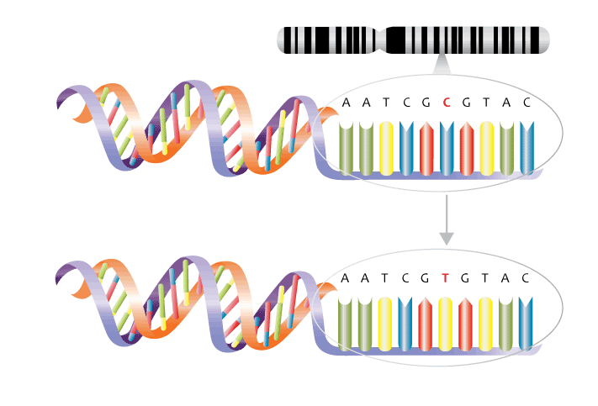
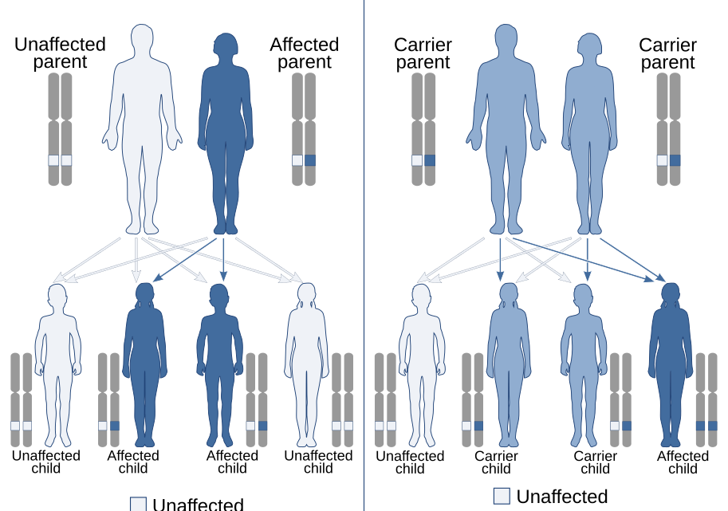
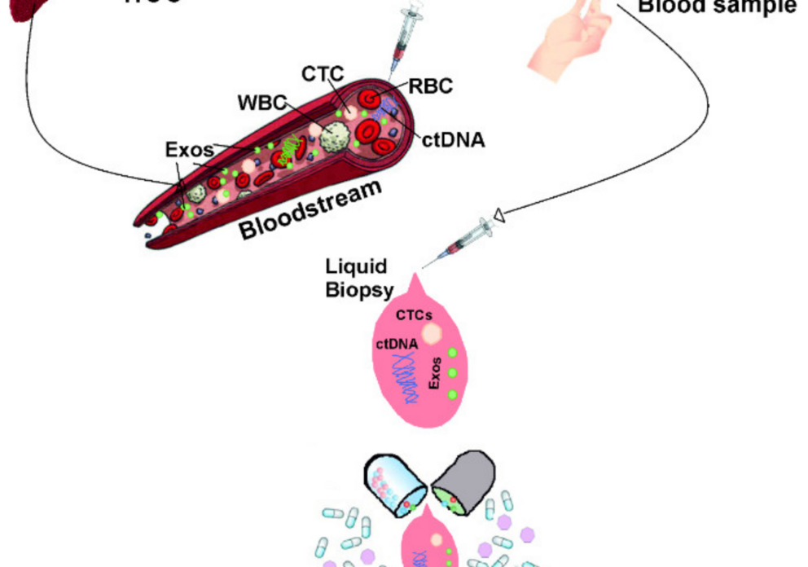
Genetic and Molecular Techniques
DNA Mutation Analysis
Polygenic Risk Score
Liquid Biopsy
Cancer Prediction Techniques
Science Presentation
Description: Identifies specific mutations in genes like BRCA1 and BRCA2 linked to breast cancer.
Strengths: Highly precise; enables personalized treatment.
Limitations: Requires access to genetic data and expertise in interpretation.
Description: Combines the effects of multiple genetic variants to predict cancer risk.
Strengths: Provides a broader risk estimate.
Limitations: Lacks specificity for individual mutations.
Description: Detects cancer cells or DNA fragments in blood samples.
Strengths: Minimally invasive; potential for early detection.
Limitations: Limited by current technology’s sensitivity and specificity.

Slide 10
Agenda
1.
Project Overview
2.
Cancer Prediction Techniques
3.
DNA & Mutations
4.
Progress So Far

Slide 11
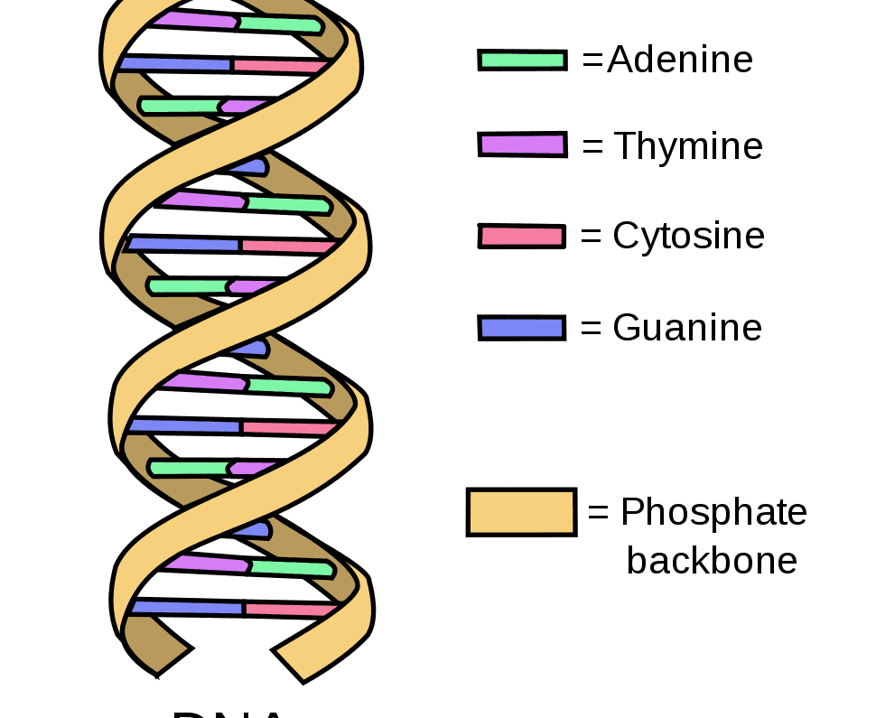
Deoxyribo-
nucleic acid (DNA)
DNA & Mutations
Science Presentation
Blueprint of life: A sequence of nucleotides (A, T, G, C).
Contains genetic information for the development, growth, and reproduction of organisms

Slide 12
DNA Mutations
DNA & Mutations
Science Presentation
Changes in the DNA sequence.
Examples: Substitutions, insertions, deletions.

Slide 13
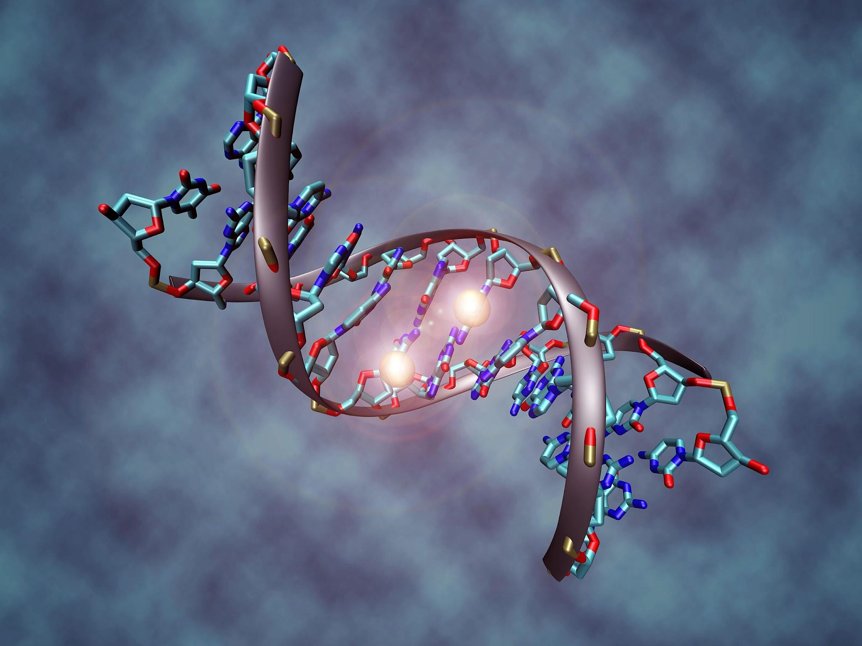
Mutation Importance
DNA & Mutations
Science Presentation
Certain mutations are strongly linked to breast cancer (e.g., BRCA1, BRCA2).
Identify specific cancer-related mutations.
Highly targeted and clinically actionable.

Slide 14
Typical Workflow: Cancer Detection using DNA
Acquire Sample
Detect Mutations
Make Prediction
Acquire the DNA Sample from blood sample
Digitize the sample
Process the raw file to detect the sequence
Use available tools & techniques
Report the mutations in the sequence
Design intelligent algorithm to interpret the mutations
Predict the probability of the disease
1
2
3

Slide 15
Mutation Detection
Raw DNA Sequence Pre Processing
Post Alignment Processing
Mutation Calling
Variant Annotation
Mutation Interpretation
Prepare raw DNA sequence data for analysis by quality control and alignment
Refine the aligned data to ensure high accuracy in mutation detection.
Detect variants (e.g., SNPs, insertions, deletions) in the DNA sequence.
Annotate variants with biological and clinical significance.
Analyze annotated mutations for relevance to breast cancer.
Output | BAM File | Refined BAM File | Variant Call Format (VCF) file | Annotated VCF | Actionable mutations
Tools | FASTQC, BWA-MEM, SAMTools | Picard, GATK Base Recalibrator | GATK HaplotypeCaller, GATK VariantFiltration | Annovar | ClinVar, COSMIC
Steps | Quality Control Alignment SAM to BAM | Mark Duplicates Base Quality Score Recalibration | Variant Calling Variant Filtering | Annotation | Variant Prioritization
Notes:
Here’s a comprehensive pipeline for detecting mutations from a DNA sequence file:
Step 1: Raw DNA Sequence Preprocessing
Description: Prepare raw DNA sequence data for analysis by quality control and alignment.
Input: DNA sequence file (e.g., FASTQ format).
Output: Aligned sequence file (e.g., BAM format).
Steps and Tools:
Quality Control
Purpose: Remove low-quality reads and adapters.
Tool: FastQC (for quality assessment), Trim Galore (for trimming).
Input: FASTQ file.
Output: Cleaned FASTQ file.
Alignment
Purpose: Map DNA reads to a reference genome.
Tool: BWA-MEM (alignment algorithm).
Input: Cleaned FASTQ file, reference genome.
Output: SAM file (sequence alignment map).
SAM to BAM Conversion
Purpose: Compress and sort the alignment file.
Tool: SAMtools.
Input: SAM file.
Output: Sorted BAM file.
Step 2: Post-Alignment Processing
Description: Refine the aligned data to ensure high accuracy in mutation detection.
Input: Sorted BAM file.
Output: Refined BAM file.
Steps and Tools:
Mark Duplicates
Purpose: Identify and flag duplicate reads to avoid false positives.
Tool: Picard Tools.
Input: Sorted BAM file.
Output: BAM file with duplicates marked.
Base Quality Score Recalibration (BQSR)
Purpose: Adjust quality scores for systematic biases.
Tool: GATK BaseRecalibrator.
Input: BAM file, reference genome, known variants.
Output: Recalibrated BAM file.
Step 3: Mutation Calling
Description: Detect variants (e.g., SNPs, insertions, deletions) in the DNA sequence.
Input: Recalibrated BAM file.
Output: Variant Call Format (VCF) file.
Steps and Tools:
Variant Calling
Purpose: Identify potential mutations.
Tool: GATK HaplotypeCaller or FreeBayes.
Input: Recalibrated BAM file, reference genome.
Output: Raw VCF file.
Variant Filtering
Purpose: Remove low-quality or spurious variants.
Tool: GATK VariantFiltration.
Input: Raw VCF file.
Output: Filtered VCF file.
Step 4: Variant Annotation
Description: Annotate variants with biological and clinical significance.
Input: Filtered VCF file.
Output: Annotated VCF file.
Steps and Tools:
Annotation
Purpose: Link variants to genes, diseases, and pathways.
Tool: ANNOVAR, SnpEff, or Ensembl VEP.
Input: Filtered VCF file.
Output: Annotated VCF file or tabular report.
Step 5: Mutation Interpretation
Description: Analyze annotated mutations for relevance to breast cancer.
Input: Annotated VCF file.
Output: List of actionable mutations with clinical significance.
Steps and Tools:
Variant Prioritization
Purpose: Focus on mutations linked to breast cancer (e.g., BRCA1/BRCA2).
Tool: Custom scripts or databases like ClinVar, COSMIC.
Input: Annotated VCF file.
Output: Final report on relevant mutations.

Slide 16
Agenda
1.
Project Overview
2.
Cancer Prediction Techniques
3.
DNA & Mutations
4.
Progress So Far

Slide 17


SAM Tools
BWA
Picard
Genome Analysis Toolkit
Integrative Genomics Viewer

Slide 18


